Slide 1


Introduction to a Legal Career at Taylor Walton

Slide 2


Introduction to Taylor Walton Solicitors
Taylor Walton is a highly regarded multi-service regional law firm with offices located in St Albans, Harpenden and Luton. The Firm provides legal advice and solutions to a range of client, such as FTSE100 and FTSE350 companies, public and private sector organisations, charities and high-net worth individuals.
Taylor Walton organise legal services by expertise; Commercial Property, Corporate & Commercial, Commercial Litigation, Property Litigation, Employment, Residential Property, Family and Private Client. Clients may well be supported through their business and private life experiences by a number of the Firm’s practice areas with many clients engaging in services for many years.
Taylor Walton’s success is attributed to the calibre of its people. In the same way that the Firm is committed to provide exceptional quality legal services to their clients, the Firm is also committed to fostering an engaging and supportive environment in which to work and develop a rewarding career, particularly for the Trainees and Apprentices. The Firm has an exceptionally high staff retention rate and an average length of service unrivalled within the region.
Taylor Walton won the Best Trainer (Medium Regional firm) award in the prestigious LawCareers.Net Training and Recruitment Awards in 2020.

Slide 3
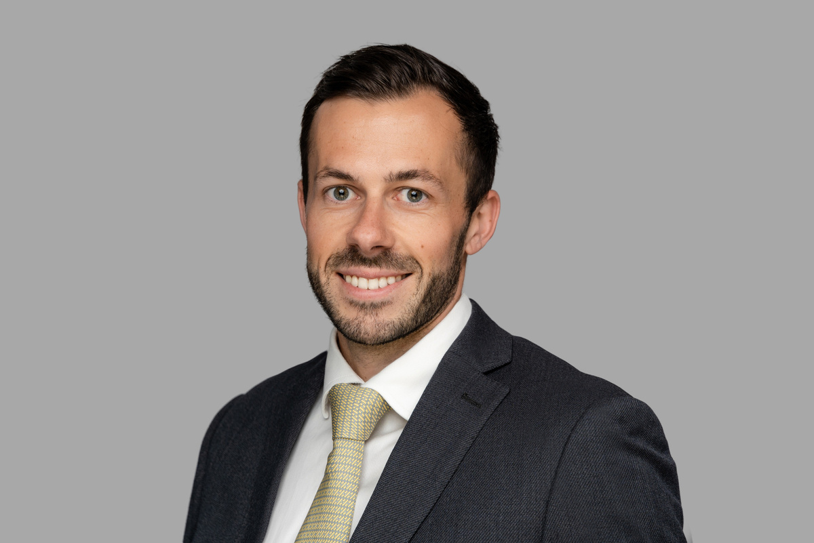
Meet Toby Walker, Associate Solicitor in Corporate & Commercial
Whilst studying the International Baccalaureate at Bedford School, I decided that I wanted to pursue a career in law, and so started a Law degree at University of Birmingham. During my first year at university, I was one of many students seeking to find a summer placement scheme in the hope it would lead to a training contract. I was already aware of Taylor Walton being a highly reputable firm in the area and therefore applied for the summer placement scheme.
My application was successful and I attended the summer placement scheme shortly after completing my second year at university. During my time on the scheme, I was able to work closely with trainees, solicitors and Partners on real matters, including attending client meetings. All the employees were welcoming during the two weeks, and ensured I was able to enjoy the experience as much as possible whilst learning what life as a solicitor was like.
The professional and friendly approach by everyone at the firm cemented my decision to apply for a training contract as I knew I would enjoy working at Taylor Walton and be able to gain valuable experience by working closely with fee earners from the start.
During my training contract, I spent 6 months in 4 departments (Employment, Commercial Litigation; Corporate and Commercial and Residential Property). I thoroughly enjoyed each seat and believe I learnt a great deal as my supervisors were always great at ensuring I took on a range of tasks in the matters, such as meeting with clients, drafting the defence or conducting a sale/purchase from start to finish. Whilst some of the work was challenging, I was always able to ask my supervisor or colleagues for assistance when needed and constantly felt I had the support from everyone at Taylor Walton.
Some of the highlights of my training contract included attending the Employment Tribunal and Royal Courts of Justice for trials, in which I had helped prepare documentation for, and dealing with complex corporate matters which required a solid strategy in order to resolve in line with our clients’ needs. I completed my 2-year training contract in September 2019, and qualified into the Corporate and Commercial Department. I am now just over 4 years qualified and an Associate with the Firm – the time goes very quickly when you are learning so much!

Slide 4
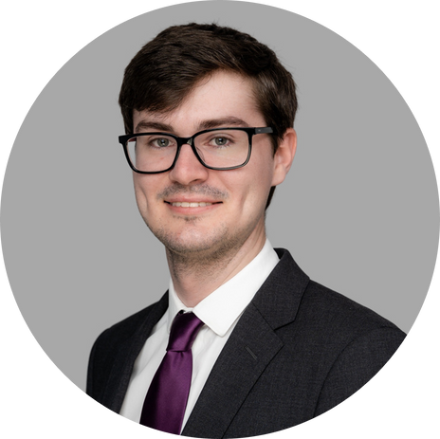
Meet Ethan Diver, Solicitor in Employment
I studied Law at the University of Bristol and completed the LPC at BPP University in London before joining Taylor Walton as a Trainee Solicitor in September 2021. I qualified as a Solicitor in the Employment Department in September 2023.
My interest in a legal career was first sparked by studying Law at A-level. I thoroughly enjoyed the interesting, varied and challenging nature of the subject which prompted me to pursue a Law degree and ultimately a Training Contract.
As a Trainee, I completed seats in the Family Department, Employment Department and Commercial Property Department. My seat rotations gave me a varied experience of private and commercial work and also gave me the opportunity to work in two of the firm’s offices, Luton and St Albans.
During my seat in the Family Department, I was involved in a range of cases from divorce proceedings to children matters to pre-nuptial agreements. I regularly attended client meetings and Court hearings and also had the opportunity to develop skills such as drafting, legal research and negotiation. During my seat in the Employment Department, I gained experience acting for clients in Employment Tribunal proceedings (including claims for discrimination and unfair dismissal) and on ‘everyday’ employment matters (such as drafting employment contracts, policies or redundancy procedures). My experience in both the Commercial Property and Corporate Departments were also very positive.
I enjoyed thorough and insightful supervision and guidance throughout each of my seats and was trusted with plenty of responsibility, including being able to give advice in client interviews and assist Counsel as the firm’s representative at hearings. This supervision has continued since my qualification although I am now being given even more responsibility and freedom to develop my skills.
I would highly recommend a Training Contract at Taylor Walton and can happily say that I have developed my knowledge and skills more than
I thought was possible. I am looking forward to what the future holds!

Slide 5
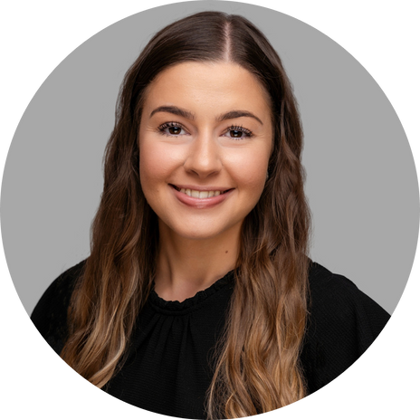
Meet Grace Welch, Paralegal in Residential Property
Hi! I’m Grace. I have been with Taylor Walton for just over 5 years. I first started as a Paralegal Apprentice after finishing my A-Levels, and have since become a qualified Paralegal and am now on my way to qualifying as a Licensed Conveyancer Lawyer (CILEx).
I am currently part-way through my training to qualify as a CILEx Lawyer with The Chartered Institute of Legal Executives (CILEx). I always knew I wanted to go into law but I wasn’t sure exactly what area would be best suited to me, and I knew that University just wasn’t the route that I wanted to take; I am a much more practical person and learn best when I am able to apply my knowledge to real life situations.
That’s why I started looking into the apprenticeship route and I have found that it suits me perfectly. I am based in Residential Property which, coming straight from Sixth Form, I knew nothing about so being able to learn on the job alongside my studies has helped me really understand the area of law and become more confident in it. I support the Head of Department, Caroline Hume, who has always shown great enthusiasm in helping me progress and is always there to help me out.
Working and studying at the same time definitely has its challenges, but in my opinion, it is completely worth it – it teaches you very early on in your career how to be organised and prioritise different tasks. In my first two years training to qualify as a Paralegal, I was eligible for a ‘study day’ once a week which would be dedicated to my CILEx work. The dedicated study day did make it easier to ensure I was completing the necessary studies but since qualifying and moving on the Advanced Stage (which I am currently completing) I am no longer considered an apprentice and therefore have to complete my studies outside of my working week.
The apprenticeship route has really helped build my confidence and I have gained so much experience very early in my career from working with Partners, Solicitors, Paralegals and Secretaries. I would recommend this route to anyone who is interested in a career in law and wants to jump straight in!

Slide 6
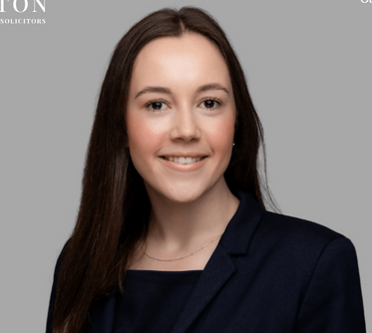
Meet Isabella Mason, Solicitor in Commercial Property & Property Litigation
Hi, I’m Isabella. I commenced my Training Contract in March 2021, and qualified as a Solicitor in March 2023.
During my Training Contract I had seats in Family, Private Client, Commercial Property and Commercial Litigation. I studied Law at the University of Hull and completed my LPC at BPP University in Leeds.
I initially became attracted to Law during my A Levels when I was involved in running a medical ethics society. I regularly organised discussions with students regarding medical law topics such as euthanasia. I then furthered this interest by securing work experience at various law firms to confirm whether I wanted to pursue the solicitor route.
I was also proactive in obtaining non-legal work experience to broaden a skillset transferable to a career in law.
I received my Training Contract offer in the final year of my law degree having attended two interviews at Taylor Walton as part of the recruitment process. After completing my LPC, I then joined the Firm as a paralegal in the Residential Property department which was invaluable experience before beginning my training as it meant that I became familiar with using a case management system.
The highlight of my Training Contract was attending hearings during my time spent in the Family Department. I was fortunate to attend hearings concerning divorce and finances, injunctions and children. I had good client contact in all of my seats and have regularly attended meetings with clients (both remotely and in-person). I was given responsibility early on in more complicated tasks which aided my learning and development and allowed me to run some matters independently.
I have enjoyed having a close working relationship with my supervisor and other fee earners in the departments which has given me opportunities to assist on lots of different tasks of varying complexity and to witness different working practices. I qualified as a Solicitor in April 2023 - into a hybrid role in both the Property Litigation and Commercial Property Departments. I am excited to continue the next step of my career with Taylor Walton.

Slide 7

Meet Alisha Afzal, Solicitor Apprentice in Private Client
Before staring the apprenticeship programme, I was unsure of the career I wanted to pursue. I attended many school fairs and applied for a range of work placements to help me decide. Through these vocational schemes and talks, I decided that I wanted to pursue a career within the legal field. This decision was further cemented at A-level Law as I found the subject the most interesting.
I initially thought there was only the one route to becoming a Solicitor, however, by chance, I stumbled upon an advertisement online for a Solicitor Apprentice role and began to research into this. Under the Apprenticeship, apprentices typically work four days a week at a law firm and attend university for one day over the course of six years to gain the legal expertise and degree to qualify.
I feel the legal apprenticeship is the best route I could have chosen as I am learning the law first hand with qualified solicitors alongside obtaining my law degree and getting the university experience - it is the best of both worlds! I recently passed my law degree, achieving a first.
I decided to apply Taylor Walton as they are a very reputable firm who also placed an emphasis on developing homegrown talent. Fortunately, I was accepted and started as an Apprentice in the Commercial Property department in September 2018. Within 6 months of starting, I learnt about the conveyancing process and was able to apply this knowledge when aiding the fee earners in my department. Some of my daily tasks included reporting to clients, raising queries with the other side solicitors and producing documents for the various legal applications.
As Apprentices, we are each allocated a supervisor. The supervisors at Taylor Walton are all very approachable and provide you with the right level of guidance to be able to carry out daily tasks to the best standard possible whilst also allowing you space to grow and enhance the qualities you have.
After two years in the Commercial Property Department and a year in the Commercial Litigation department, I completed 6 months in both our Family and Employment Departments. I moved into our Private Department in September 2023 and am really enjoying it so far.

Slide 8
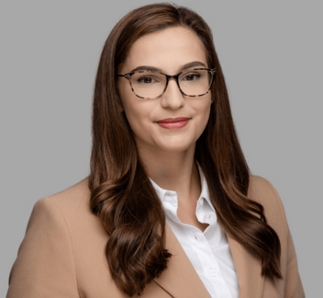
Meet Ellie Thompson, Trainee Solicitor in Commercial Litigation
I am currently a Trainee Solicitor in my final seat in our Commercial Litigation Department in Luton.
I studied Law and Criminology at Cardiff University before going on to take my LPC with a Business Management Masters at the University of Law.
Before applying to Taylor Walton (and following the end of my degree) I worked as a Corporate Paralegal, which sparked my interest for law, and made me decide to qualify as a Solicitor.
In July 2021, I attended Taylor Walton’s Summer Placement Scheme. Although at the time (due to the pandemic) the scheme was held virtually, I was still able to get a good insight into the Firm and its culture. Everyone I spoke to throughout the week was very welcoming, and the friendly and professional nature of the Firm further confirmed my decision to apply for a Training Contract with them.
I started at Taylor Walton as a Trainee Solicitor in September 2022. I completed my first seat in our Private Client Department in St Albans, and my second seat in Commercial Property in Luton. My third seat was in the Employment Department. I am now undertaking my final seat before I am due to qualify as a Solicitor in September 2024.
A highlight of my Training Contract so far has been my time in Commercial Property which allowed me to get involved in a wide range of transactions, including landlord and tenant matters, property development and property re-financing.
I also enjoyed my work in Private Client - under supervision I was able to act as a key point of contact for clients, delivering services relating to the drafting of Wills and Power of Attorney documents and dealing with Probate matters.
I am looking forward to learning more about Commercial Litigation, and look forward to what the future holds!

Slide 9
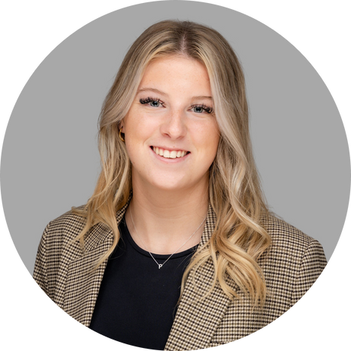
Meet Phoebe Craig, Legal Apprentice in Residential Property
Hi, I’m Phoebe and I work in the Residential Property department in our St Albans office. I finished my A Levels in 2022 and decided that I wasn’t suited to university, so started to apply for degree apprenticeships in law. Even though I didn’t take law at A level, I knew I wanted to go into law after attending various careers fairs and speaking with many different law firms. I applied for a few different legal degree apprenticeships and was accepted by Taylor Walton. I started at Taylor Walton in September 2022.
Doing an apprenticeship is very different to university. I found it scary coming into an environment where I felt like I didn’t know what I was doing but each supervisor at Taylor Walton has been so supportive to the point where I felt confident to talk to clients over the phone and in person very quickly.
Joining straight from sixth form, I had no idea about Residential Property, which had never been an area of Law I had heard much about. Learning on the job and then studying alongside has really helped me to put the theory to use. I quickly realised that I really enjoy this department as there's something new to learn every day. It helps that the people around me are happy to help with anything I'm stuck on.
The course itself is very flexible. I complete it alongside work so can do this in my own time and on my designated study day. As an apprentice you get 1 study day a week which gives me time to catch up and meet deadlines that have been set. You have a dedicated tutor, as well as a group of people completing the course alongside you. There tends to be a catch up Zoom call once a month - however you can always email the tutor if you're stuck!
Having completed an exam on the English Legal System, I am now starting the next chapter in contract law and will qualify as a Level 4 Conveyancing Paralegal in around 3 years’ time! I hope then to go on to the next stage apprenticeship and qualify as a Licensed Conveyancer.

Slide 10
Not all Law Firms are the Same
    Consider the size - by headcount & number of Partners
    What sort of clients does the firm service? Businesses or private individuals
    Legal practice areas
    Location/type – city, high-street, national, regional
    Opportunities – retention rate & progression
    How does the firm support its staff and the community? Wellbeing policy, Social events, CSR within the community
    Where might you best fit?
    Discover your personality, strengths and interests

Slide 11
Useful Websites
    lawcareers.net - this is a great resource for finding out information on careers in the law
    SRA.org.uk - the Solicitors Regulation Authority webpage
    CILEX.org.uk - the Chartered Legal Executive website. Contains information about qualifying as a CILEX Lawyer
    nationalcareers.service.gov.uk - provides careers information, advice and guidance
    notgoingtouni.co.uk - showcases alternatives to the standard university route to school and college leavers

Slide 12
Pathways to Law
A-Levels/A-Level Equivalent
Paralegal Apprenticeship
Solicitor Apprenticeship
Non-Law Degree/Degree Equivalent
Law Degree
Chartered Legal Executive Apprenticeship/Self study
Complete Law Degree
PGDL
SQE 1 & 2
SQE 1 & 2
SQE 1 & 2
Qualify as Chartered Legal Executive
Qualifying Work Experience (2 Years)
Pass Character and Suitability Test
Qualify as a Solicitor

Slide 13
Working at Taylor Walton - the Social Side
    Trainee/Apprentice and Paralegal Socials – all of our Trainees, Apprentices and Paralegals meet up regularly for drinks and meals throughout the year.
    Friday@5 – on the first Friday of every month, each office is invited to get together and celebrate the end of the week. Friday@5 events have included drinks in the local pub, bowling, bounce in London and Topgolf in Watford!
    Bi-monthly Office ‘breakfasts’
    Christmas Party - each year the Firm holds a Christmas party. Previous themes have included ‘Hollywood’ and previous venues include Luton Hoo!
    Taylor Walton has annual Cricket and Rounders tournaments – no matter their ability, everyone in the Firm gets involved!
    We also participate in local events, such as the Harpenden Carnival.
    Our Trainees and Apprentices are heavily involved in our employee-led CSR programme of charity fundraising events. We are proud to support several local charities such as Harpenden Trust, Earthworks St Albans, Keech Hospice and Rennie Grove

Slide 14

Our Website
You can find a copy of this handout at the bottom of the Trainee page of our website - ‘Our career journeys - an introduction to the routes into Law’

Slide 15
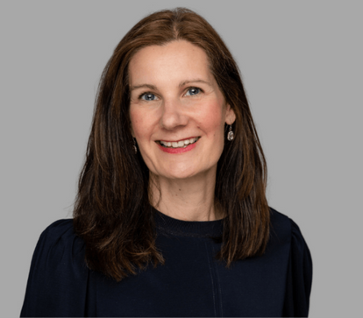
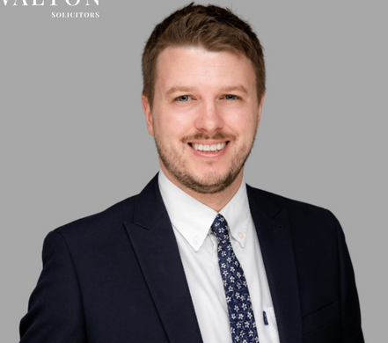
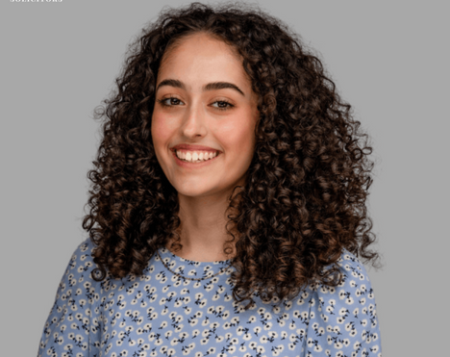
How To Get In Touch
For more details, including how to apply, please see the ‘Careers’ section of our website.
For details of our vacancies and further opportunities, please visit:
www.taylorwalton.co.uk
Stephanie Simon
People and Talent Partner
stephanie.simon@taylorwalton.co.uk
Stuart Soley
People and Talent Executive
stuart.soley@taylorwalton.co.uk
Aliya Virji
People & Talent Assistant
aliya.virji@taylorwalton.co.uk

